Slide 1
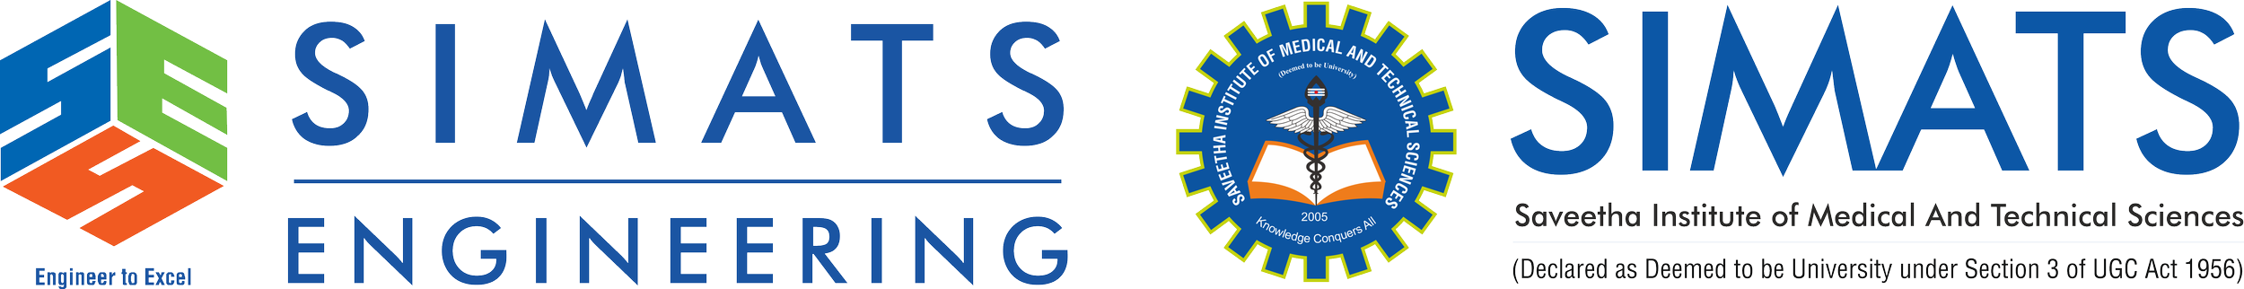
ASSESSMENT TOOL 3
CSA0501
DATABASE MANAGEMENT SYSTEM
Under guidance: Jaya Mabel Rani A
Presented By:
Mukesh Raj L – 192571036

Slide 2


INTRODUCTION
What is DBMS?
A Database Management System (DBMS) is software that stores, organizes, retrieves, and manages data efficiently. It acts as an interface between users and databases, ensuring data is secure, accurate, and easy to access.
Why DBMS?
Organizes large amounts of data
Reduces redundancy
Provides security
Supports multiple users
Ensures data consistency
Examples
MySQL
Oracle
SQL Server
PostgreSQL
MongoDB

Slide 3
Applications and Advantages of DBMS
Objectives
Organize data efficiently
Reduce redundancy
Maintain consistency
Improve security
Support multiple users
Advantages
Reduced data redundancy
Improved security
Faster data retrieval
Backup and recovery
Applications
Banking
Hospital
Library
E-commerce
Railway Reservation

Slide 4
File System vs DBMS
File System | DBMS
Data stored in files | Data stored in database
High redundancy | Low redundancy
Less secure | Highly secure
Difficult backup | Easy backup
No relationships | Supports relationships
Slow searching | Fast querying
Limited users | Multiple users
Example Hospital departments maintain separate patient records, causing duplicate information | Example Bank: DBMS stores customer information once and all services access the same database.

Slide 5
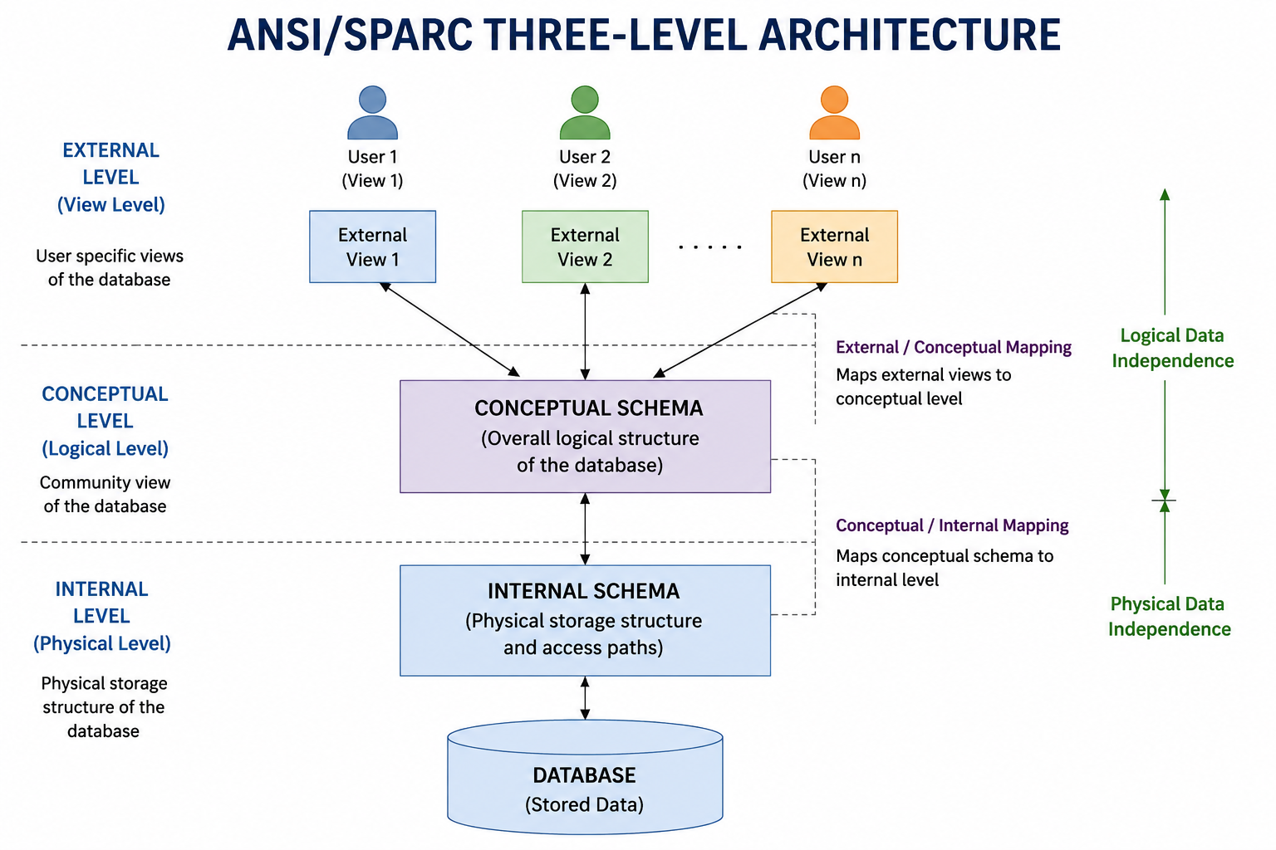
ANSI/SPARC ARCHITECTURE Three-Level Architecture External Level (View Level) Conceptual Level (Logical Level) Internal Level (Physical Level) Purpose Provides data abstraction and data independence. External Level User-specific views Different users see different data Conceptual Level Overall logical structure Defines entities and relationships Internal Level Physical storage of data File organization and indexing

Slide 6
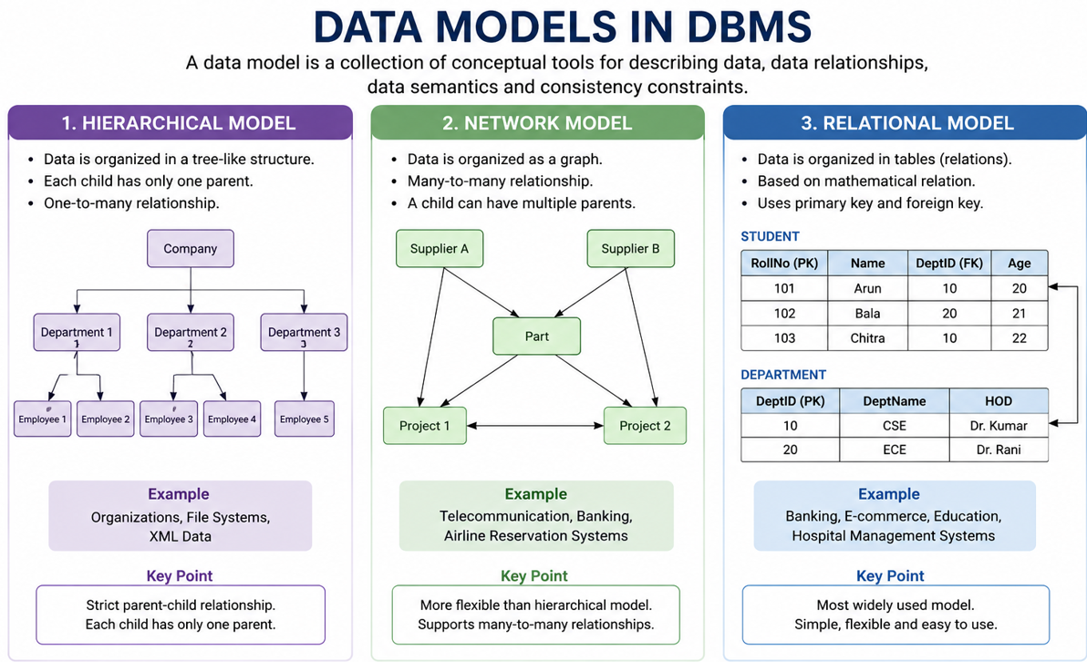
Database Models
Types of Data Models
Hierarchical Model
Tree structure
One parent → Many children
Example: Company Organization Chart
Network Model
Many-to-many relationships
Example: Student enrolled in multiple courses
Relational Model
Data stored in tables
Most widely used model
Example: Student Table

Slide 7
INDUSTRY USE CASES
Model | Industry
Hierarchical | File Systems
Network | Telecommunication
Relational | Banking, Hospitals, Colleges

Slide 8
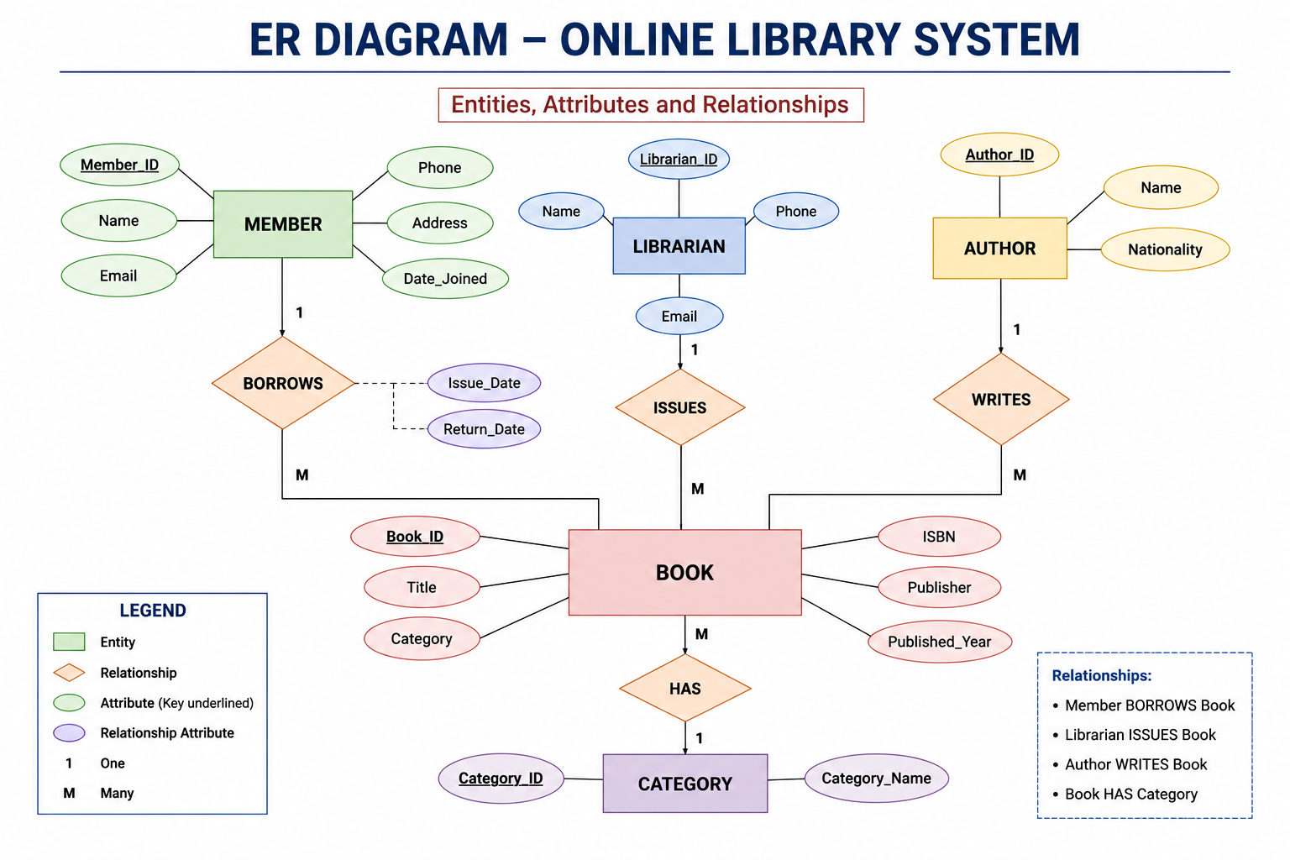
ER diagram Online Library System Entities Book Member Librarian Issue Author Relationships Member borrows Book Librarian issues Book Author writes Book ER COMPONENTS Entity Attribute Relationship Primary Key Foreign Key Benefits Simplifies database design Represents real-world objects

Slide 9
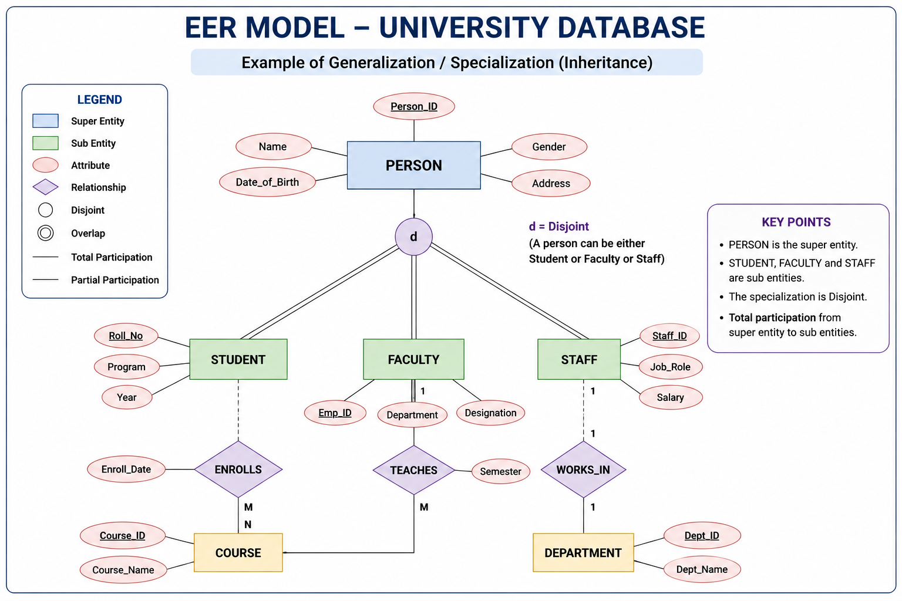
EER MODEL
Enhanced Entity Relationship Model
Features
Generalization
Specialization
Inheritance
Categories
Example
University Database
Person → Student, Faculty
UNIVERSITY CASE STUDY
Superclass
Person
Subclasses
Student
Professor
Staff
Advantages
Avoids redundancy
Better organization

Slide 10
DATA INDEPENDENCE
Types
Physical Data Independence
Storage changes do not affect logical structure.
Logical Data Independence
Logical changes do not affect user views.
Importance
Easy maintenance
Better scalability
Significance of Data Independence
Simplifies database maintenance.
Reduces application changes.
Improves flexibility and scalability.
Enhances system performance.
Ensures data consistency and reliability.

Slide 11
SOFTWARE COMPONENTS OF DBMS
Main Components
Query Processor
Interprets and executes SQL queries.
Optimizes query execution.
2. Storage Manager
Stores, retrieves, and updates data.
Manages files and indexes.
3. Transaction Manager
Ensures ACID properties.
Maintains data consistency during transactions.

Slide 12
STRONG & WEAK ENTITIES
Strong Entity
Has Primary Key
Exists independently
Example: Customer
Weak Entity
No Primary Key
Depends on Strong Entity
Example: Order Item

Slide 13
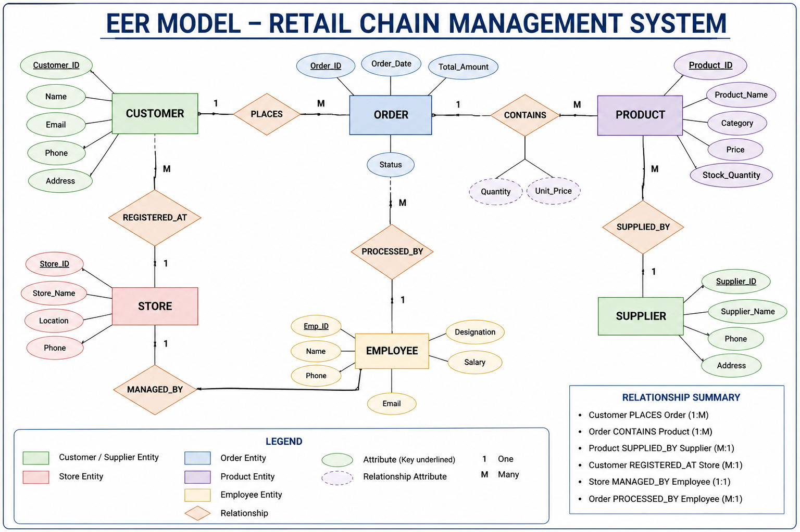
RETAIL CHAIN EER MODEL
Entities
Customer
Product
Supplier
Store
Employee
Order
Relationships
Customer → Places → Order
Store → Sells → Product
Supplier → Supplies → Product
Employee → Works in → Store

Slide 14
Conclusion
Conclusion
In this presentation, we learned about:
DBMS fundamentals
Applications
Advantages
File System vs DBMS
Database Models
Normalization
ER Diagram
Inventory Management System
Database Users
SQL Commands
Aggregate Functions
Joins
A Database Management System is the backbone of modern applications. It provides efficient data storage, security, integrity, and fast access, making it an essential technology in industries such as banking, healthcare, education, e-commerce, and government services.
09

Slide 15
Conclusion
THANK YOU
09

